Slide 1
Case Study – Budweiser Brewery Insights
MSDS 6306: Doing Data Science – Spring 2020
<GROUP NAME HERE>
Indy Dhillon, Jamie Vo, & Nick Blair

Slide 2
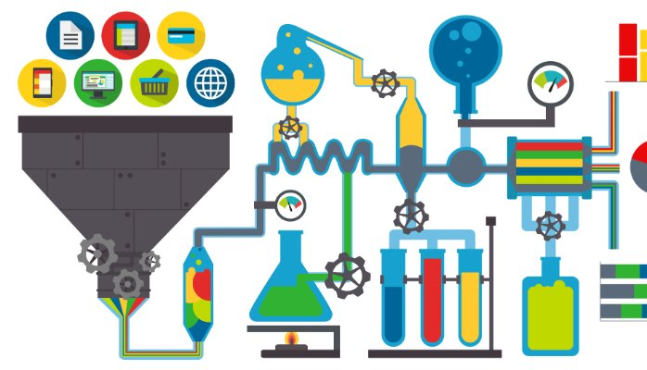
Overview of study
Preparing the datasets
Computing relevant statistics
Providing useful summaries, inferences, & insights
http://gcmouli.com/blog/2017/01/inference-and-insights/

Slide 3
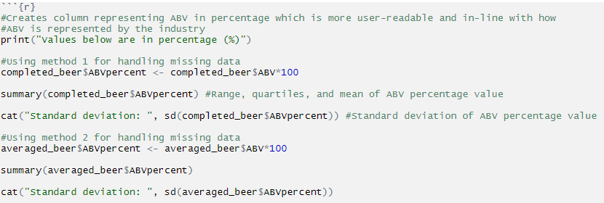
Summary of Statistical Findings - ABV
Solution using R

Slide 4
Summary of Statistical Findings - ABV
Using missing data method 1:
Minimum: 2.7%
1st Quartile: 5.0%
Median: 5.7%
3rd Quartile: 6.8%
Maximum: 12.5%
Mean 5.991%
Standard Deviation: 1.358
Using missing data method 2:
Minimum: 0.100%
1st Quartile : 5.0%
Median: 5.7%
3rd Quartile : 6.7%
Max: 12.8%
Mean: 5.977%
Standard Deviation : 1.337

Slide 5
Summary of Statistical Findings - ABV
Using missing data method 1:
Minimum: 2.7%
1st Quartile: 5.0%
Median: 5.7%
3rd Quartile: 6.8%
Maximum: 12.5%
Mean 5.991%
Standard Deviation: 1.358
Using missing data method 2:
Minimum: 0.100%
1st Quartile : 5.0%
Median: 5.7%
3rd Quartile : 6.7%
Max: 12.8%
Mean: 5.977%
Standard Deviation : 1.337

Slide 6
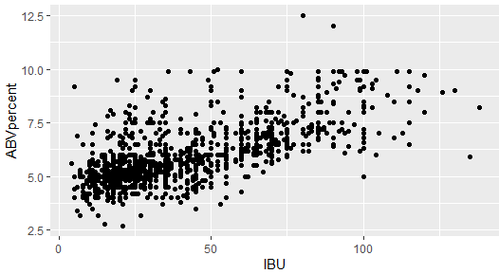
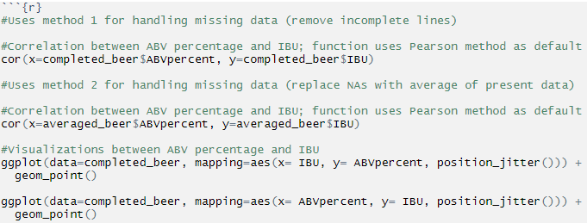
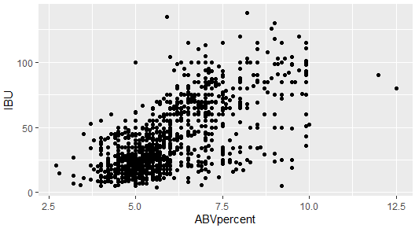
Relationship between ABV & IBU
Solution using R

Slide 7
Relationship between ABV & IBU
Using both methods for accounting for missing data, there appears to be a moderate to moderately-strong correlation between increasing bitterness (IBU) and alcohol content (ABV).
Using method 1, the correlation between the two variables using Pearson’s R is 0.671 indicating a moderately strong connection.
Using method 2, the correlation between the two variables using Pearson’s R is 0.520 indicating a moderate connection.

Slide 8
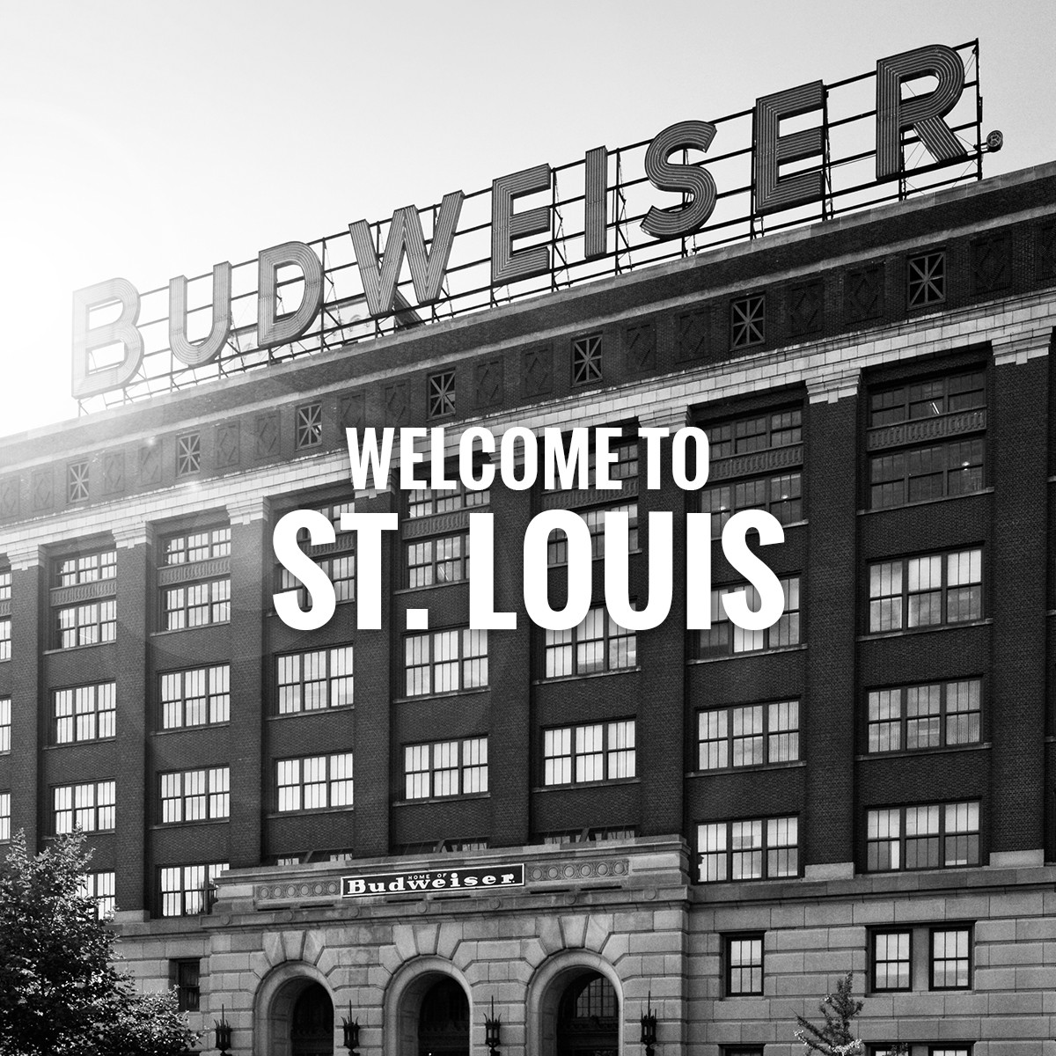
Thank you for your time and considertation!
Further questions or concerns? Please contact:
Indhy Dhillon (idhillon@smu.edu)
Jamie Vo (jamiev@smu.edu)
Nick Blair (nicholasb@smu.edu)
Photo credit: https://www.budweisertours.com/locations/st-louis-missouri.html

Slide 9
<Problem?>
<Solution code/explanation>

Slide 10
<Problem?>
<Written conclusion>

